Slide 1
Technological University(Meiktila)
Department of Information Technology
Personal Information for Teachers in TU (Meiktila)
(1st Seminar)
24-8-2023
Supervised By Dr. Myat Thu Aye
Project Group VI

Slide 2
Members of OUR TEAM
Han Htal Wint
Lwin Aung
Wa Thone Kyaw
V-IT-22
V-IT-23
V-IT-27

Slide 3







Outlines Of Presentation
Introduction
Flow Diagram
Abstract
Requirements
Objective
Background Theories
Summary

Slide 4
INTRODUCTION
Personal Information for Teachers in TU (Meiktila) is used to retrieve people information and personal data easily . It shows a variety information such as people's ID , parents name, parents ID and necessaries for personal affairs .
It is the exciting time at the People Personal Information for Teachers in TU (Meiktila) . At the leading of provider of data , People Information Directory is responding to change in Technology , to provide data to HR (Human Resource) with an effortless easy steps .

Slide 5
ABSTRACT
This system can reduce the counts that the employes had to fill out their personal information every time that the HR and office asked for it .
This is wanted to be easy in the modern internet era , saving time and not having to fill it out repeatedly the personal data by employee.
This system can send a notification message to the employee whenever it needs an update data.
This system can also reduce valuable time and save the word by reducing the use of papers .

Slide 6
Objectives
To improved data quality.
To increased operational efficiency.
To get real time data from the employee. By using this anyone can check in real time by using digital data form .
To get better data access. Re-entering data from paper forms can take hours or even days. With a digital solution, data is available in real-time. The Admin of HR can access the data more than a paper.
To reduce costs. Paper document management and archiving can be an intensive and expensive work.
To get more reliable backups. improves the ability to properly backup all content and ensure that they can readily retrieve it.

Slide 7

BACKGROUND THEORY
Background idea of the system​
React.js​
Node.js

Slide 8
Background Idea of the System
The background idea of a Personal Information for Teachers in TU (Meiktila) system is rooted in the need for individuals and organizations to manage and organize their personal data. This system is designed to provide a central repository for storing, organizing, and accessing a wide range of data.
One of the key theories behind the system is the idea of a "digital memory" or "digital brain."
The goal of these system is to provide users with a comprehensive, organized, and easily accessible repository for all of personal data . This allows users to more effectively manage their data and reduces the risk of data loss or duplication.

Slide 9
React.js is a JavaScript library for building user interfaces. It was developed and is maintained by Facebook.​
React is based on a component-based approach to building user interfaces, the use of a virtual DOM for efficient updates and rendering, and a declarative syntax for easier understanding and development.​
React.js

Slide 10
Node.js
Node.js is based on its use of Google's V8 JavaScript engine, its event-driven, non-blocking I/O model, and its large and growing ecosystem of modules and libraries. These features make it a fast, efficient, and scalable platform for server-side programming in JavaScript.

Slide 11
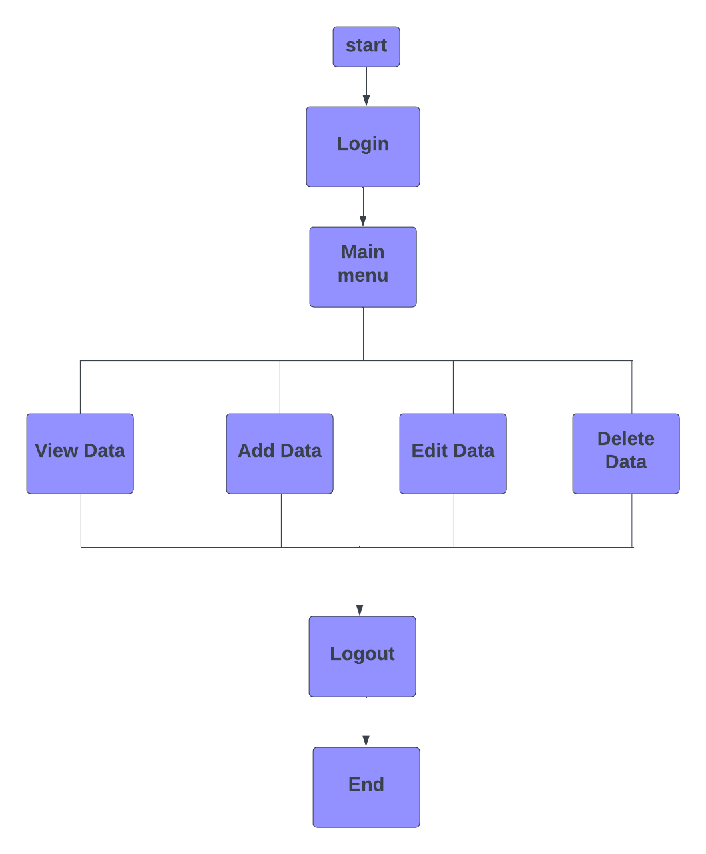
Flow Diagram
For User

Slide 12






Requirements
Frontend | Backend | DATABASE | System Requirements
React.js | Node.js | Mongo DB | Window 8 , 10 ,11
Next.js | Express.js |  | Minimum core i3, 7 gen , Ram 4

Slide 13

SUMMARY
This Personal Information for Teachers in TU (Meiktila) can help an admin to search and look out for information under digital platform , from personal ID to any other requirements for the personal information.
HR admin can easily get the information data with an effortless with this system .

Slide 14

THANK YOU

